Slide 1
DATABASES
Data storage

Slide 2
DATABASES
🔹 Baze podataka nam omogućavaju da podatke spremimo trajno i da se mogu dohvaćati po potrebi.
👉 Bez baze, Nakon restarta, svi podaci su izbrisani i vraćeni na početno stanje
👉Zato što su podaci pohranjeni u privremenoj memoriji (RAM-u).
Postoje dvije glavne vrste baza podataka:
✔ SQL baze podataka –relacijske (strukturirane)
✔ NoSQL baze podataka nerelacijske (nema stroge strukture)

Slide 3
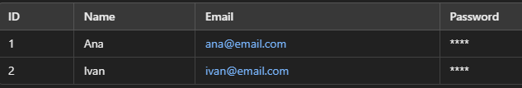
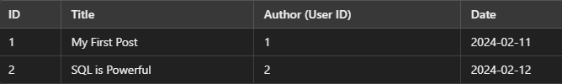
DATABASES - SQL
👉 SQL (Structured Query Language) is a language that allows queries over a structured database. 👉These databases have been around for decades and are also called relational databases. 👉The data is organized into tables (similar to Excel spreadsheets). 👉Each table contains columns (columns) that define data types. 👉 Each row of the table is a new record. 👉 Relationships between data allow tables to be connected. 👉 Every blog post has a foreign key. 👉 We can easily retrieve all posts of a particular user using SQL queries.
✔ PostgreSQL 🏆 (the most popular among developers!) ✔ MySQL ✔ SQLite ✔ Microsoft SQL Server ✔ Oracle Database (but costs $$$)

Slide 4
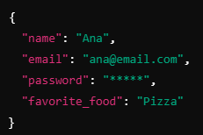
DATABASES - NOSQL
👉 The data is stored as JSON objects instead of tables. 👉There is no fixed structure, which means that we can dynamically add fields. 👉We can add a new field to any user without changing the entire database. 👉Flexibility – each user can have different attributes.
✔ MongoDB (the most popular NoSQL) ✔ Redis ✔ DynamoDB (Amazon Database)
Notes:
https://github.com/rwaldron/idiomatic.js – kako pisati dobar javascript kod.
📌 Kratka Povijest Web Preglednika
🔹 Netscape Navigator – Dominirao web preglednicima 90-ih godina. 🔹 Internet Explorer – Glavni konkurent, izazvao „rat preglednika“. 🔹 Mosaic – Prethodnik Netscapea, jedan od prvih preglednika. 🔹 Firefox – Nastao iz ostataka Netscapea, donio inovacije.
Marc Andreessen, jedan od ključnih ljudi iza Netscapea, imao je viziju dinamičnog weba, a kako bi to omogućio, bilo je potrebno razviti novi skriptni jezik koji bi radio u pregledniku.
📌 Nastanak JavaScripta
🔹 1995. godine – Web stranice su bile statične, a sav posao obrade podataka odvijao se na serveru. 🔹 Netscapeov tim – Želio je dinamičan web s animacijama i interakcijom u pregledniku. 🔹 Brendan Eich – Unajmljen da razvije skriptni jezik, kreirao JavaScript za samo 10 dana! 🔹 Prvotni naziv – JavaScript se u početku zvao LiveScript, ali zbog popularnosti Jave, ime je promijenjeno.
📌 Što Se Događa Ako Isključimo JavaScript?
🔹 Twitter bez JavaScripta – Ne može prikazati brojač znakova kod tvitanja. 🔹 YouTube i Netflix – Ne rade uopće bez JavaScripta. 🔹 New York Times bez JavaScripta – Sajt se učitava bez oglasa jer su oni često temeljeni na JavaScriptu.
Ovo pokazuje koliko smo danas ovisni o JavaScriptu – bez njega, internet ne bi bio isti!

Slide 5
DATABASES – OVERVIEW
This is a controversial topic among developers. 🔥 💡 SQL databases are structured, reliable, and efficient for large projects. 💡 NoSQL databases are more flexible and easier for beginners, but they can cause problems with large systems. 🏆 PostgreSQL is the most popular database among professionals! ➡ MongoDB is popular among beginners, but many professional developers prefer SQL.
🎯 Why are we going to learn PostgreSQL? 📌 PostgreSQL is the best choice because: ✔ Free and open-source ✔ Fast and scalable ✔ Reliable for large projects ✔ Most popular among professionals
Notes:
https://github.com/rwaldron/idiomatic.js – kako pisati dobar javascript kod.
📌 Kratka Povijest Web Preglednika
🔹 Netscape Navigator – Dominirao web preglednicima 90-ih godina. 🔹 Internet Explorer – Glavni konkurent, izazvao „rat preglednika“. 🔹 Mosaic – Prethodnik Netscapea, jedan od prvih preglednika. 🔹 Firefox – Nastao iz ostataka Netscapea, donio inovacije.
Marc Andreessen, jedan od ključnih ljudi iza Netscapea, imao je viziju dinamičnog weba, a kako bi to omogućio, bilo je potrebno razviti novi skriptni jezik koji bi radio u pregledniku.
📌 Nastanak JavaScripta
🔹 1995. godine – Web stranice su bile statične, a sav posao obrade podataka odvijao se na serveru. 🔹 Netscapeov tim – Želio je dinamičan web s animacijama i interakcijom u pregledniku. 🔹 Brendan Eich – Unajmljen da razvije skriptni jezik, kreirao JavaScript za samo 10 dana! 🔹 Prvotni naziv – JavaScript se u početku zvao LiveScript, ali zbog popularnosti Jave, ime je promijenjeno.
📌 Što Se Događa Ako Isključimo JavaScript?
🔹 Twitter bez JavaScripta – Ne može prikazati brojač znakova kod tvitanja. 🔹 YouTube i Netflix – Ne rade uopće bez JavaScripta. 🔹 New York Times bez JavaScripta – Sajt se učitava bez oglasa jer su oni često temeljeni na JavaScriptu.
Ovo pokazuje koliko smo danas ovisni o JavaScriptu – bez njega, internet ne bi bio isti!

Slide 6
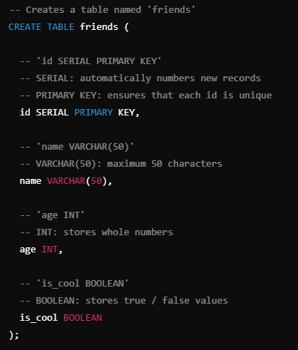
DATABASES – POSGRESQL DATA TYPES
PostgreSQL offers a wider range of data types compared to standard SQL. 🔹 Textual data: VARCHAR(n) – Variable text length (maximum n characters) TEXT – Unlimited text length 🔹 Numbers: INT – Integers BIGINT – Large integers (for billions of records) DECIMAL(10,2) – Decimal numbers (e.g. prices) 🔹 Date and time: DATE – Stores only the date TIMESTAMP – Stores the date and time 🔹 Other: BOOLEAN – true / false values SERIAL – Auto-incrementing number for primary keys 📌 What format to use for text? VARCHAR(50) = limit to 50 characters TEXT = no restriction
💡 U modernim aplikacijama često se koristi TEXT jer nema problema s ograničenjem duljine. Postoji mali gubitak brzine, ali je fleksibilnije za rastuće baze podataka.
Notes:
Instaliranje u local 1. Windows Users: Download the Postgres Installer here:
https://sbp.enterprisedb.com/getfile.jsp?fileid=1258649
1. Mac Users: Download the Postgres Installer here:
https://sbp.enterprisedb.com/getfile.jsp?fileid=1258653
https://www.postgresql.org/docs/current/datatype.html

Slide 7
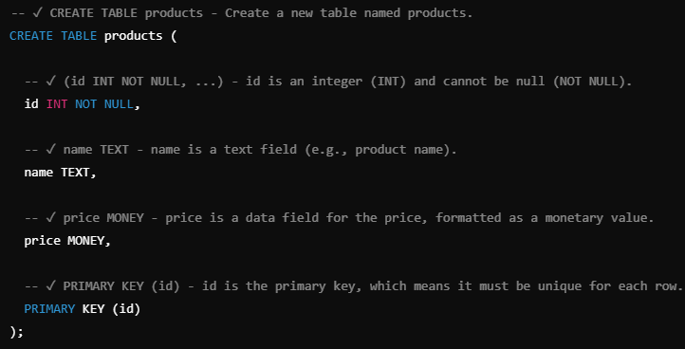
DATABASES – CREATE TABLE
SQL is a query language that we can: 👉 Add data 👉 Retrieve data 👉 Update data 👉 Clear data
Notes:
w3schools.com/sql
sqliteonline.com

Slide 8



DATABASES – INSERT
👉 Example of adding the first product
👉 Adding another product (but no price)
👉 Example that causes the error:
Notes:
w3schools.com/sql
sqliteonline.com

Slide 9



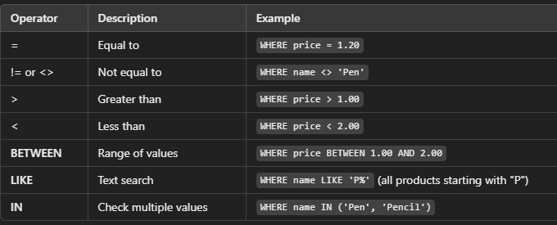
DATABASES – SELECT
👉 Retrieve all data 👉 If we do not want all the columns, we can only indicate the ones that interest us 👉 How to filter data?
Notes:
w3schools.com/sql
sqliteonline.com

Slide 10






DATABASES – UPDATE & DELETE
👉 Updating data in the SQL database
Caution!!
👉 Update multiple columns at once
Caution!!
👉 Delete data
👉 How to delete ALL data but keep the table?

Slide 11
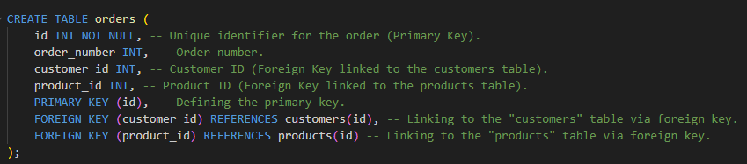

DATABASES – SQL RELATIONS & JOIN
👉 Primary Key (PK) – Identifies each record within the table (unique ID).
👉 Add your first order

Slide 12

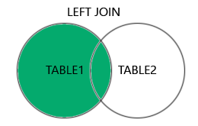
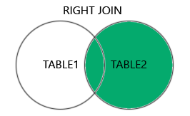
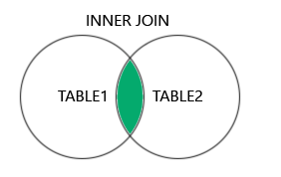
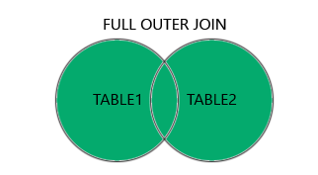
DATABASES – SQL RELATIONS & JOIN
👉 One of the most powerful functionalities of SQL is JOIN, which allows us to join tables based on the relationships between them.
There are different types of JOINS in SQL: 👉 INNER JOIN – Joins only those rows that have a match in both tables. 👉 LEFT JOIN – Includes all rows from the left table and only matching ones from the right. 👉 RIGHT JOIN – The opposite of LEFT JOIN. 👉 FULL JOIN – Returns all rows from both tables, regardless of match.

